Slide 1
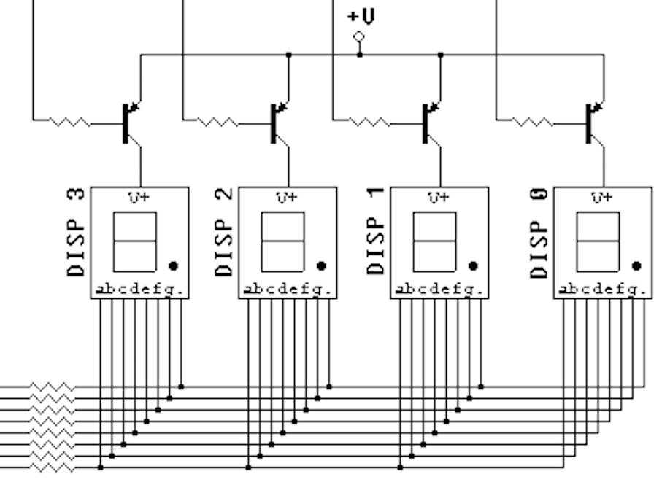
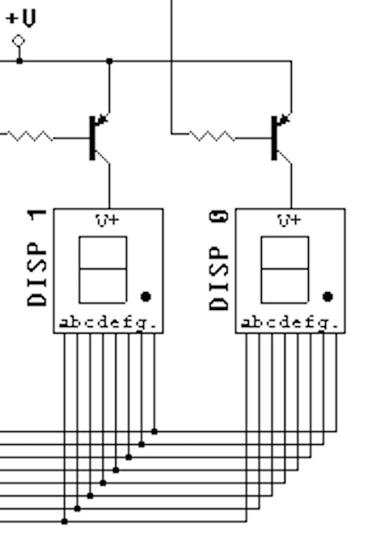
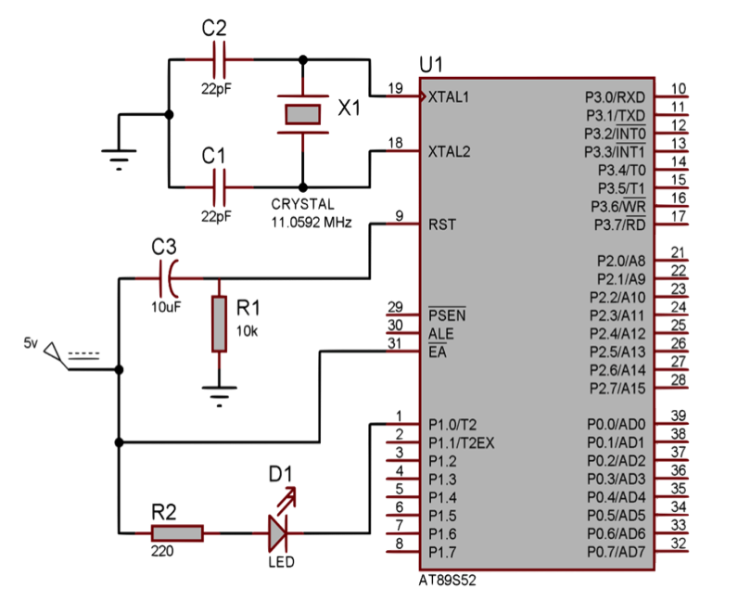
+5 V
+5 V
40
10k
R3
Vcc
DISP 6
DISP 5
DISP 4
DISP 3
DISP 2
DISP 1
.gfedcba
.gfedcba
.gfedcba
.gfedcba
.gfedcba
.gfedcba
GND
AT89S52
20
Prof. Eduardo Augusto Bezerra
EEL/CTC/UFSC
July/2021

