Slide 1
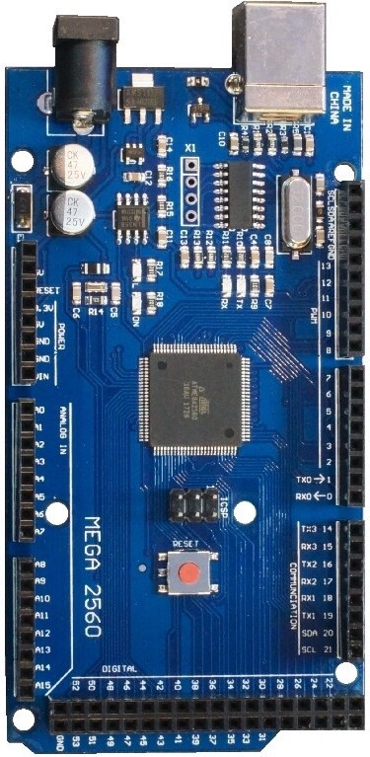
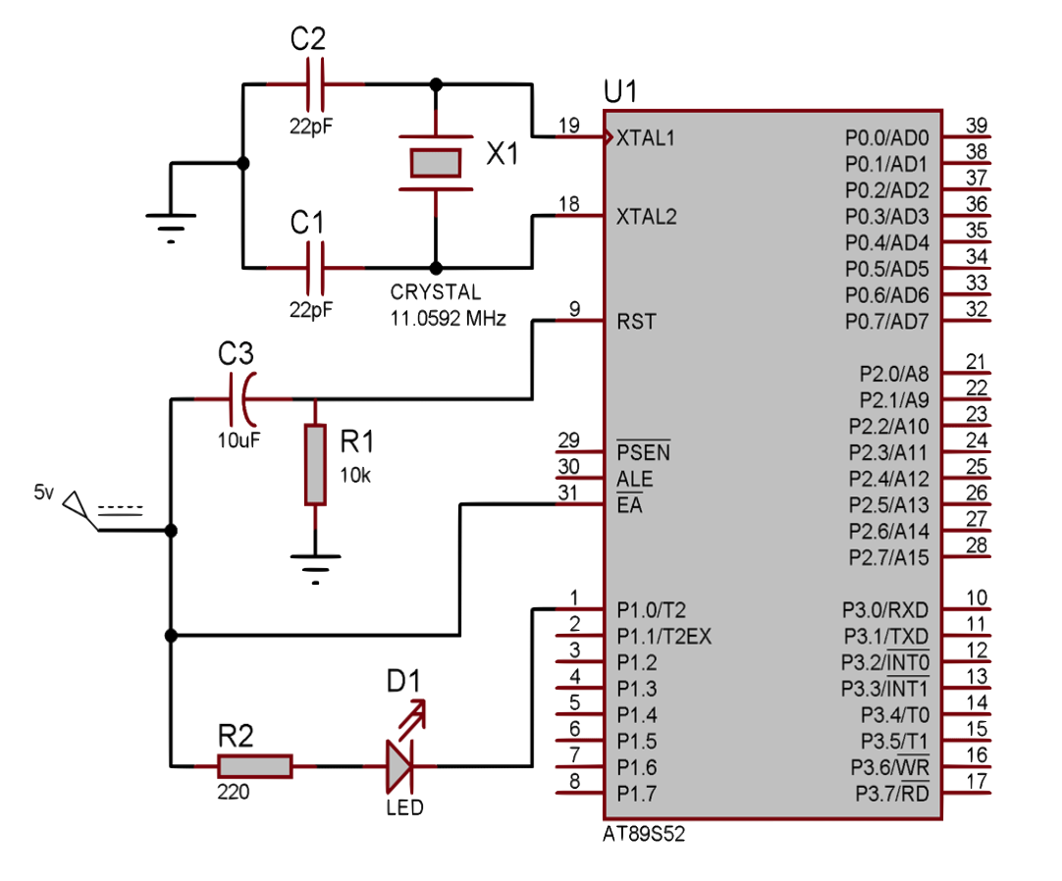
+5 V
R3
40
1k
Vcc
10
RESET
9
8
R4
7
220
R5
220
R6
GND
220
LED on P1^0
AT89S52
20
52
SCK
50
MISO
51
MOSI

